Slide 1
Plant species identification using computer vision
Data Science capstone, fall 2018
Jack Crum

Slide 2
Introduction
Endangered Species Act of 1973: Section 2(a)(2)
“The policy of Congress that all Federal departments and agencies shall seek to conserve endangered species and threatened species and shall utilize their authorities in furtherance of the purposes of this Act.”
Expenditures on endangered species conservation plans total more than $800 million annually and include 218 plant species
Department of Defense (DoD) has the highest density of endangered species of any other federal agency, with 340 out of 420 large military installations requiring active conservation management plans to protect 492 listed species (274 animals, 218 plants).

Slide 3
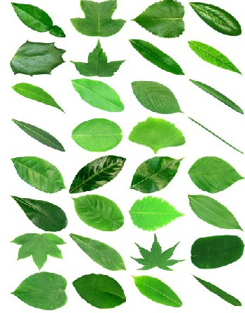
Problem statement
Large amounts of available images and data are ignored or overlooked due to lack of automation, manpower, and resources
Previously developed CNN models have good accuracy with leaves on white backgrounds (Flavia Dataset), not tested with natural background
The most popular current applications for planet identification still suffer from inabilities to deal with cluttered backgrounds and have single uploads
Project focus is to save conservation resources by developing a simple automated system for uploading large folders of images, identifying species in images, and sorting based on prediction

Slide 4
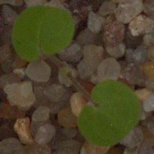
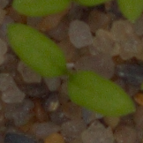
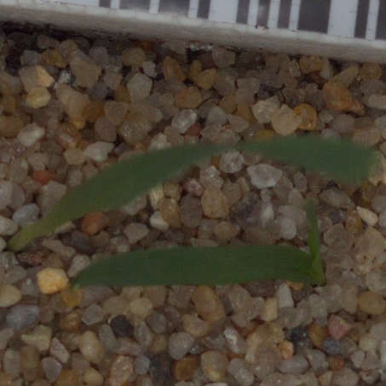
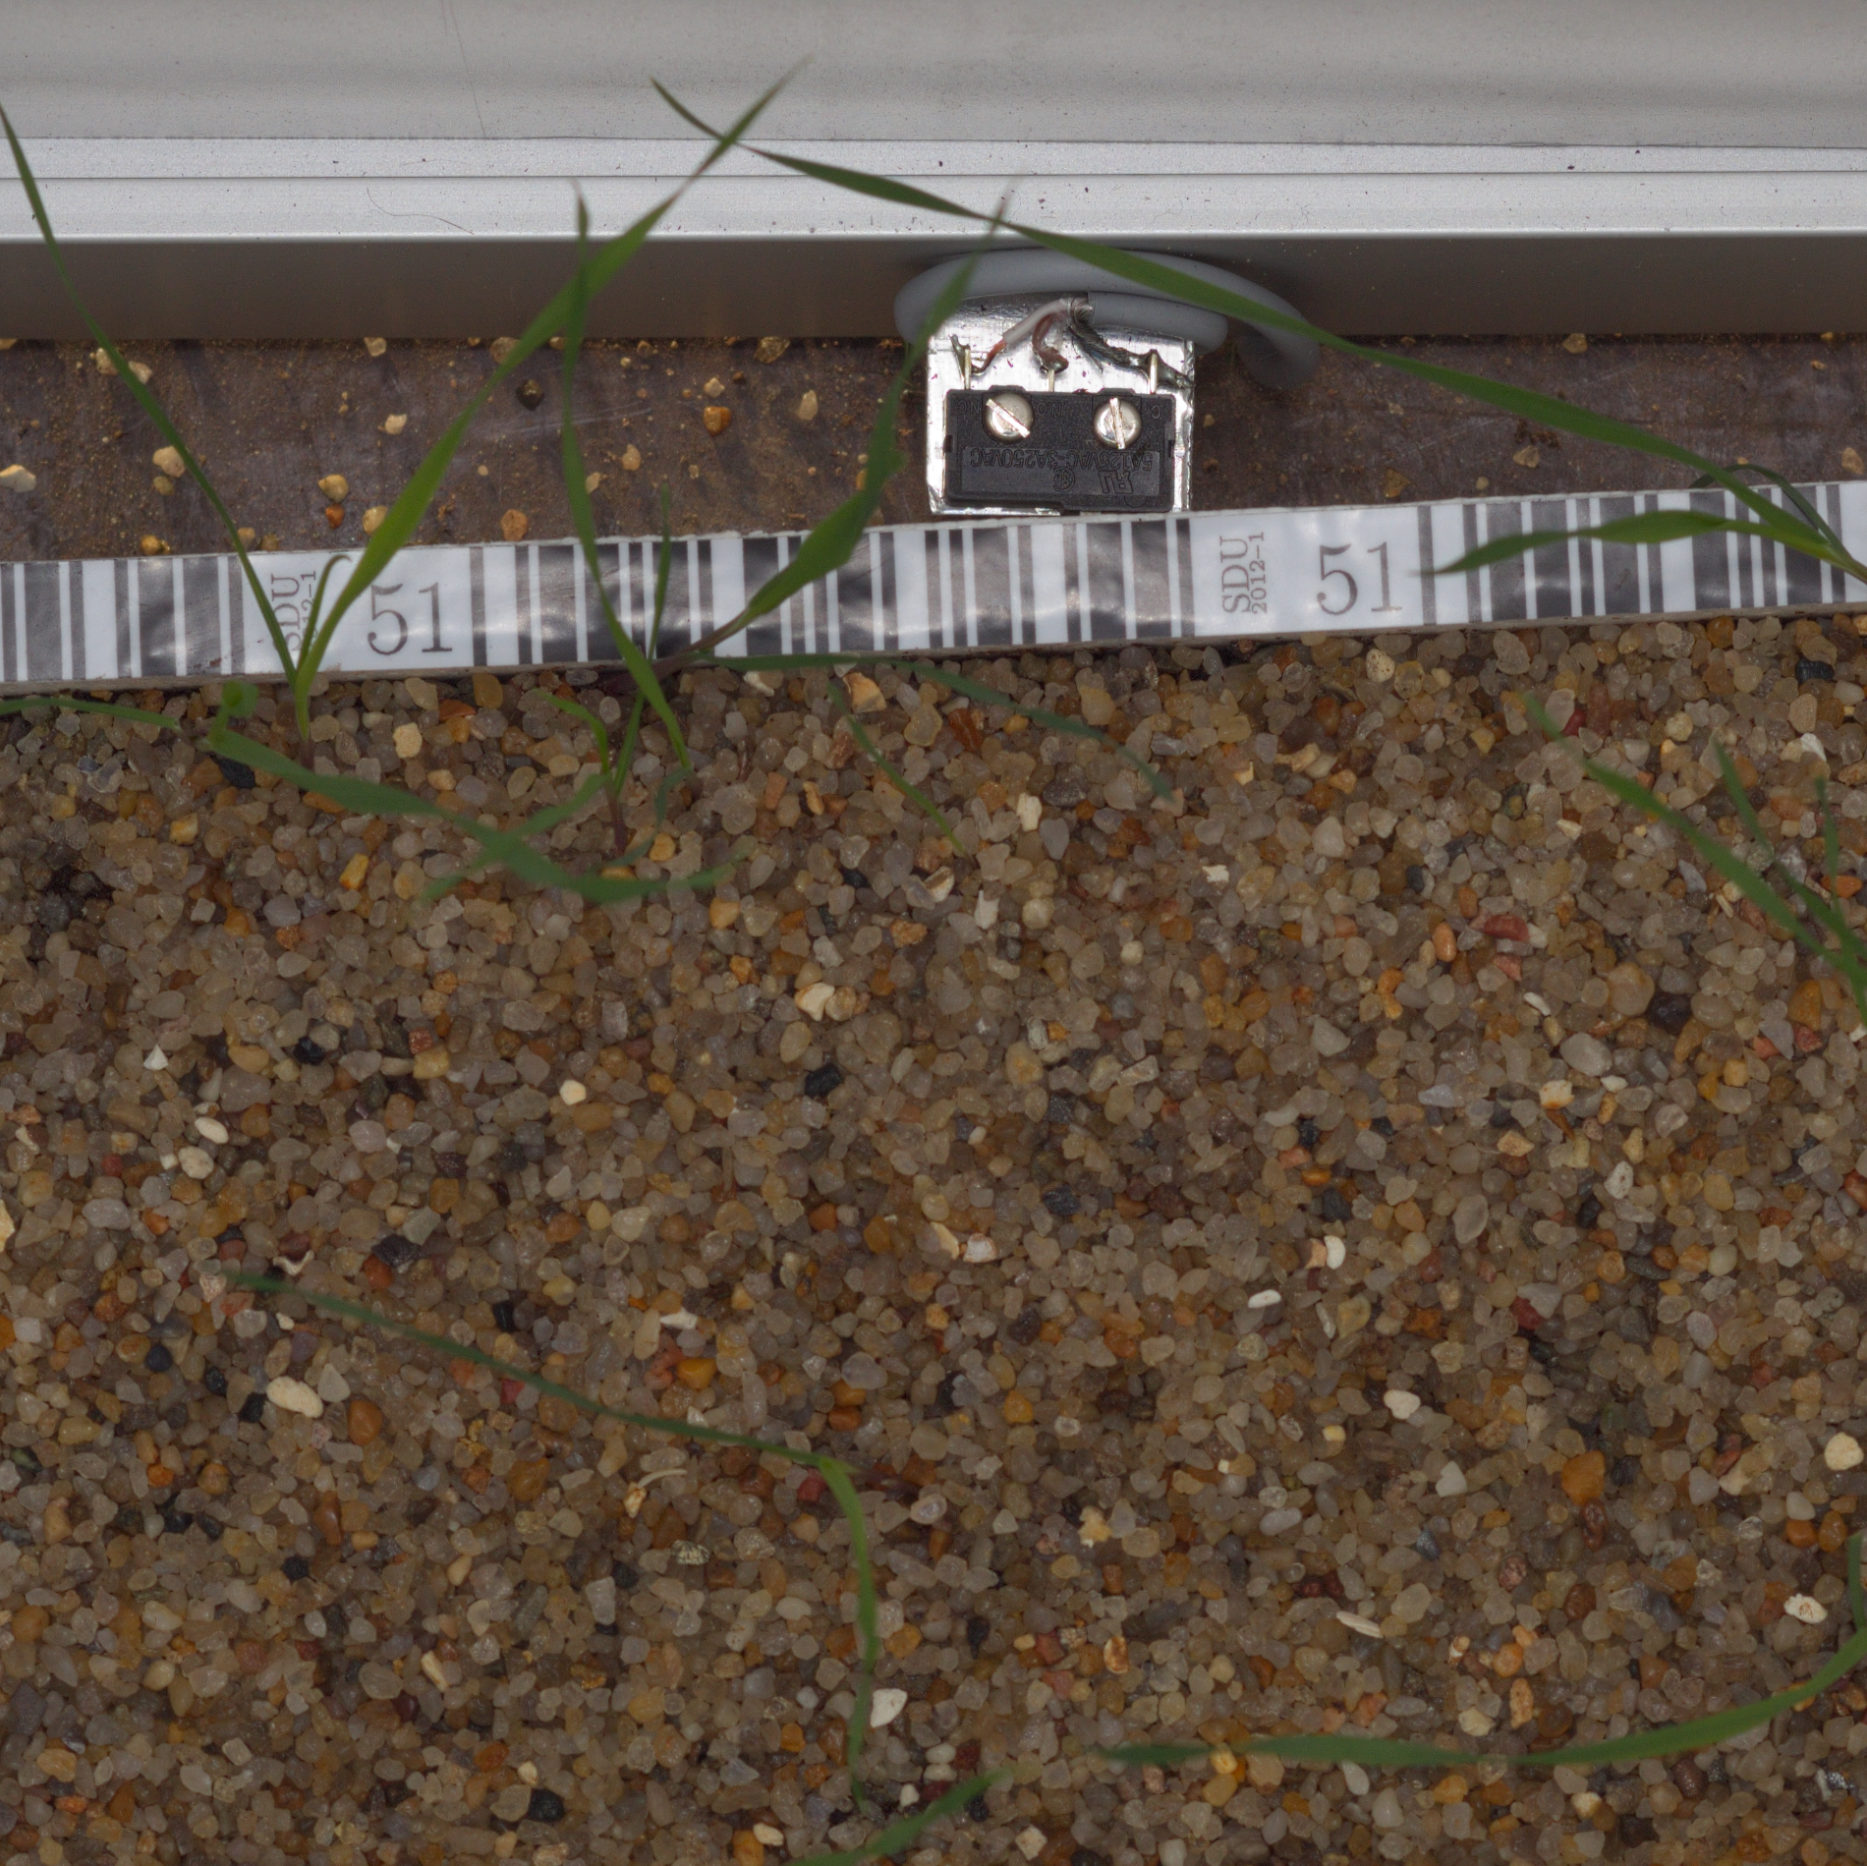
DataSet
Kaggle Plant Seedlings Classification Dataset
12 species in pre-split training/testing datasets
4750 training images
794 testing images
Testing set is not labelled
Uneven class distribution

Slide 5
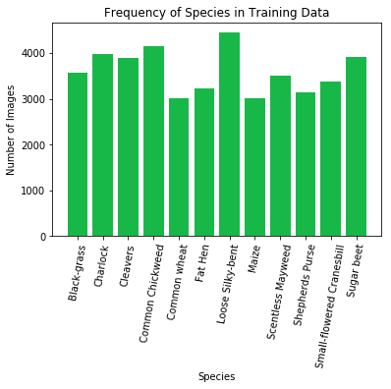
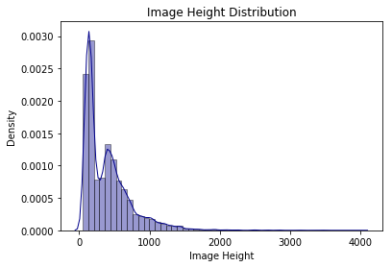
Data Augmentation
All Images were rotated 90˚, 180˚, and 270˚
Some were horizontally flipped and vertically flipped to create more uniform class distributions
50884 total images from original training set: 43255 training and 7589 validation

Slide 6
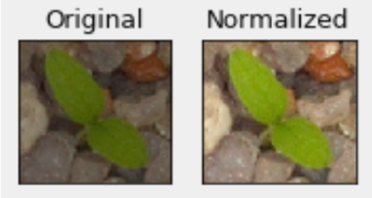
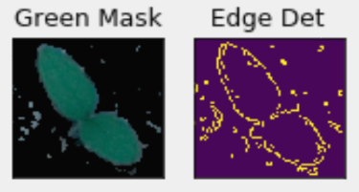
Image Preprocessing
OpenCV Library
Normalization
Extends image color range to full color range (0 to 255)
Canny Edge Detector
Noise Reduction, Edge Gradient and Direction, Sure Edge Thresholding
Green Mask
Set acceptable range on the green color channel

Slide 7

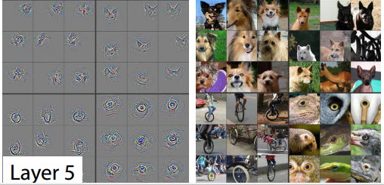
Neural Networks
Convolutional Neural Network
Convolutional Layers
Stride over image with various number of weight matrices to detect edges and patterns
Max Pooling Layers
Shrink images based on maximum value in kernel
Flatten
Flatten into 1d array
Dense Layer
Fully connected layer
Softmax Output
Class probability

Slide 8
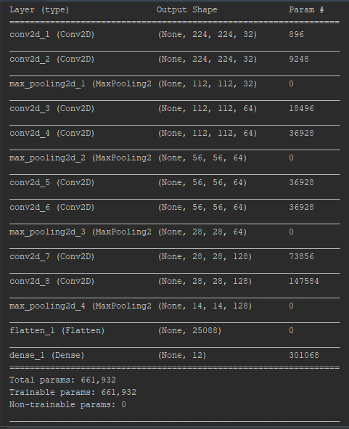
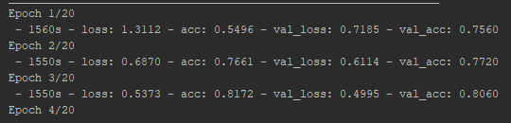
Initial CNN Results
14 layers CNN with 8 convolutions
80-81% training and validation accuracy after 3 epochs
Long training time (~26 minutes per epoch)

Slide 9
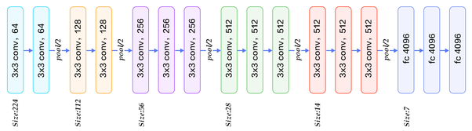
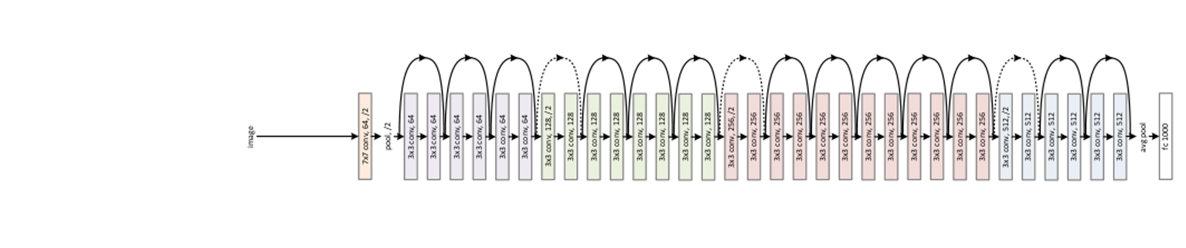
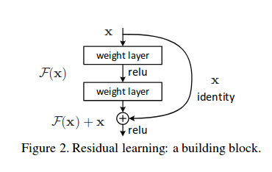
Transfer Learning
VGG-16
ResNet-50

Slide 10

Flask Application
Python micro web framework to develop web applications
Connect frontend JavaScript with backend Python using templates and connect pages using route decorators
Upload files through upload bar, run each image in file through model, output graphics, and sort on local file system
Often used with MongoDB, possibly use for storing image metadata for future analysis

